Slide 1
Predictive Modeling in Health Care
Analyzing Patient Outcomes Using Machine Learning Techniques

Slide 2
Data set description and EDA
It has 91,713 instances and 85 features represents patient and encounter , clinical and vital signs, Conditions and Comorbidities and Death Risk Probabilities information.
All instances are numerical, Irrelevant instances are deleted and deleted rows with null values, did label encoding and feature scaling is done.
To predict hospital death, demographic data, ICU-related detail, Glasgow Coma Scale, BP, Respiratory rate, Diseases, Diagnosis codes, Surgical Information, Hospital Death and ICU Death are key predictors

Slide 3
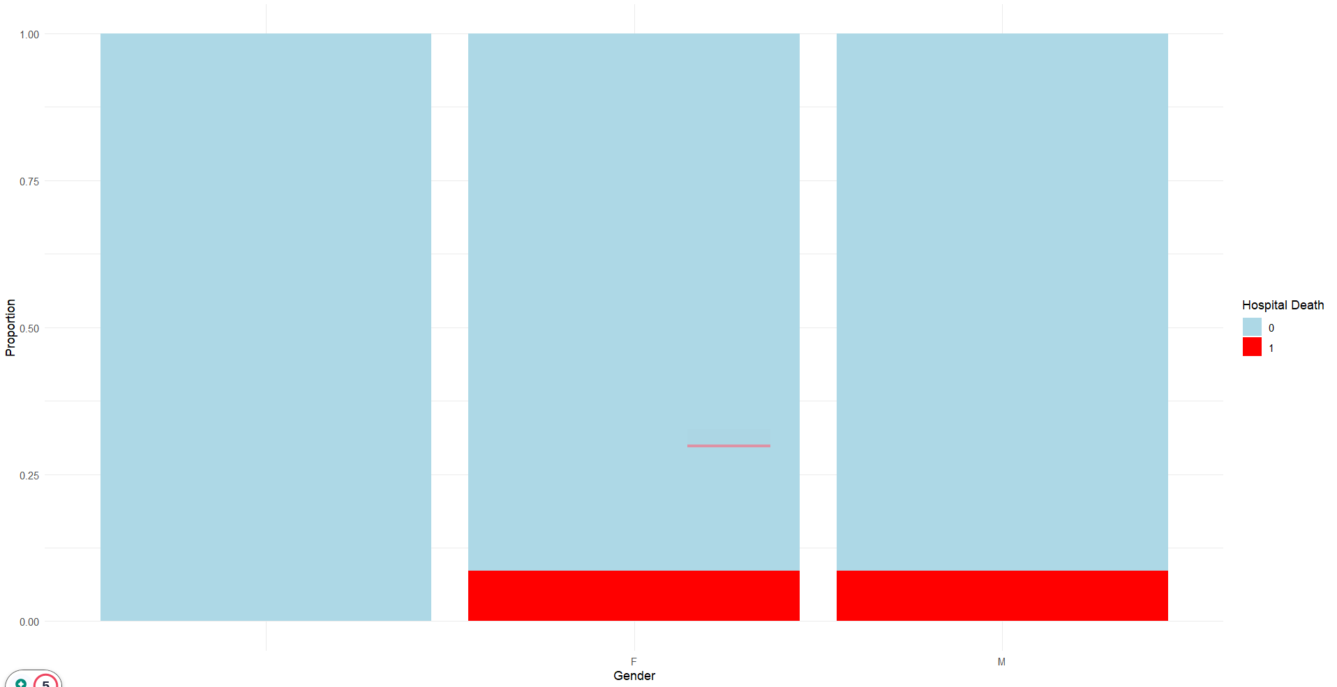
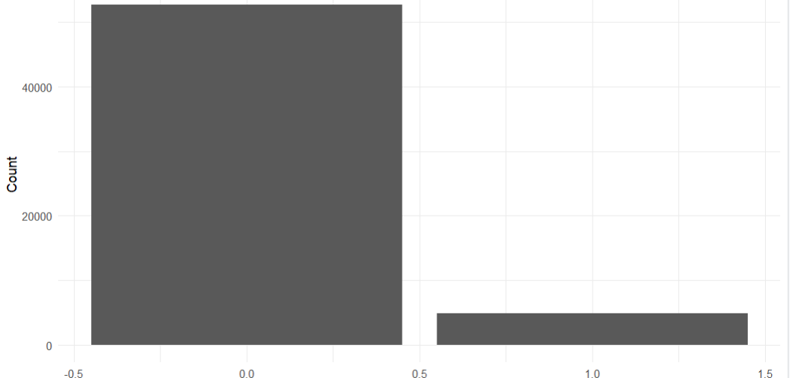
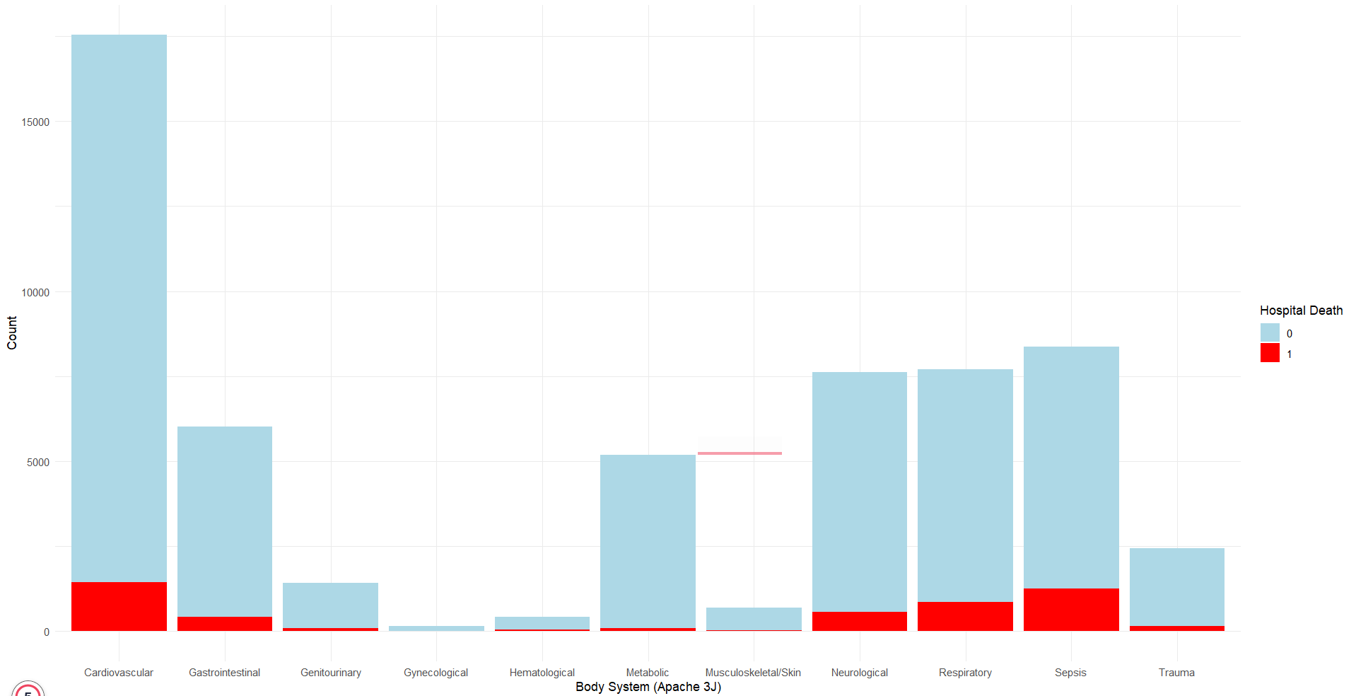
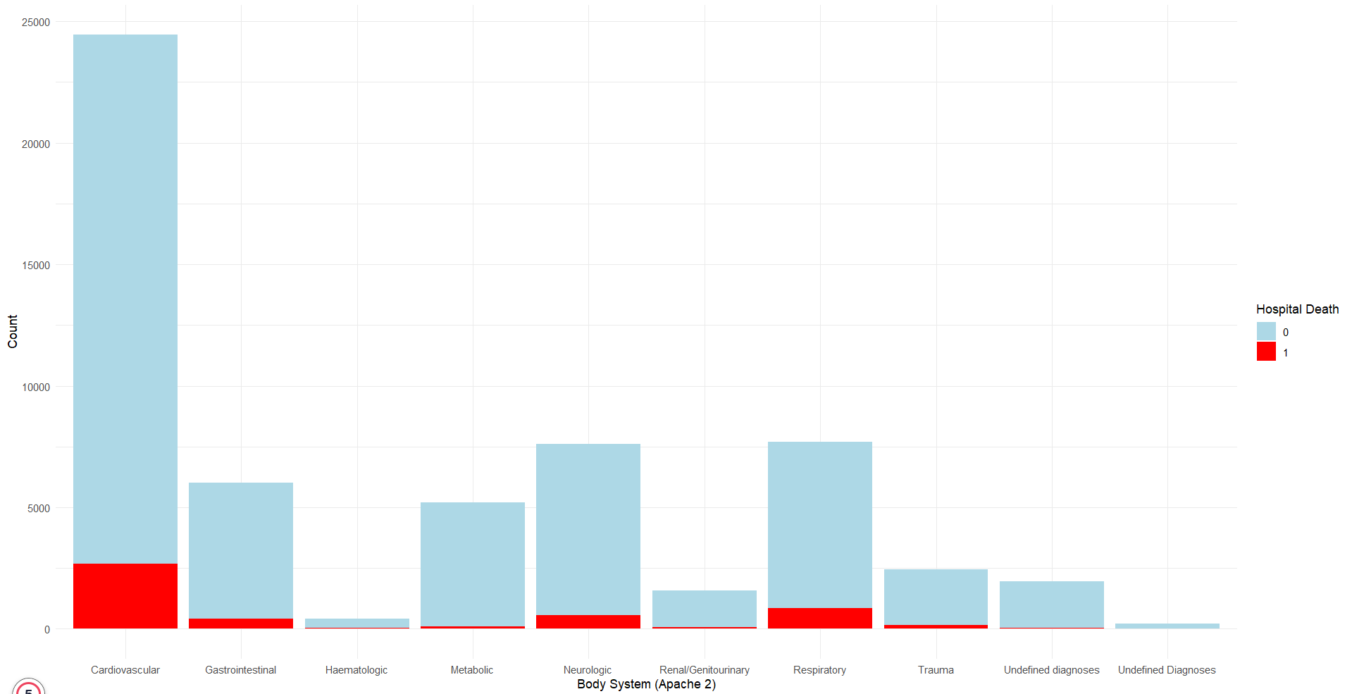
Descriptive Analysis
Chart 1: There’s a clear imbalance in the dataset, with a significantly higher count of survivors (hospital death = 0) compared to deaths (hospital death = 1).
Chart 2: Gender distribution does not show a significant difference in survival rates.
Chart 3: The Respiratory and Sepsis categories show high mortality rates, which might be critical areas of focus for healthcare interventions.
Chart 4: Highlight that the Neurologic, Respiratory, and Cardiovascular systems have the highest counts, with a significant portion of deaths associated with these systems.

Slide 4
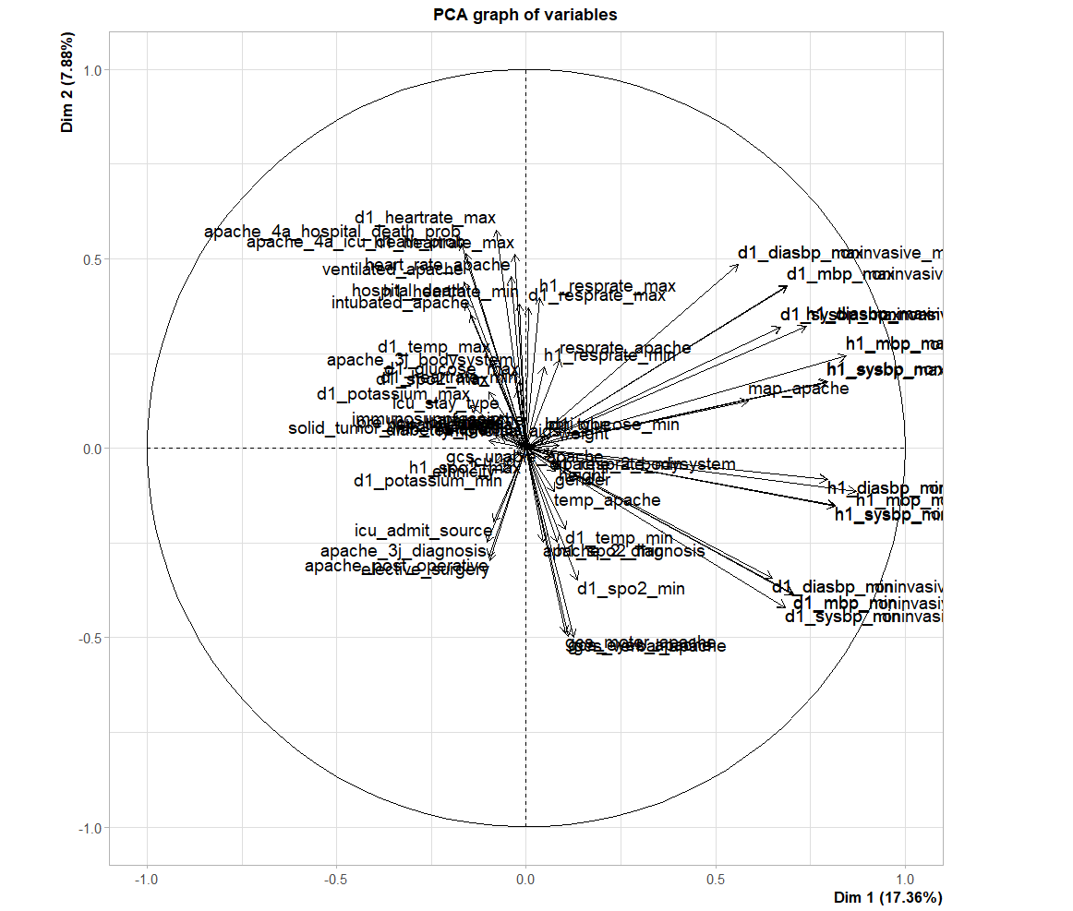
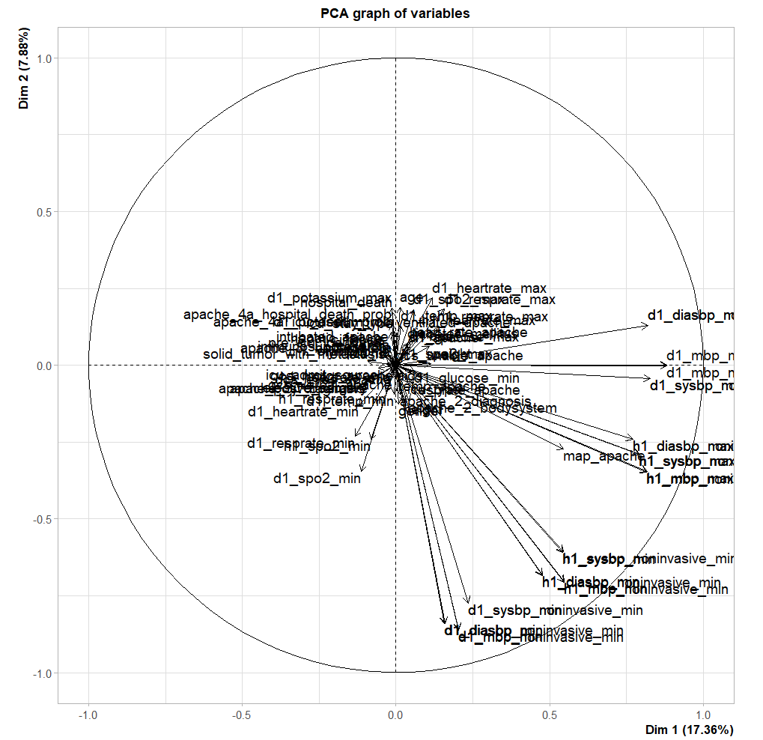
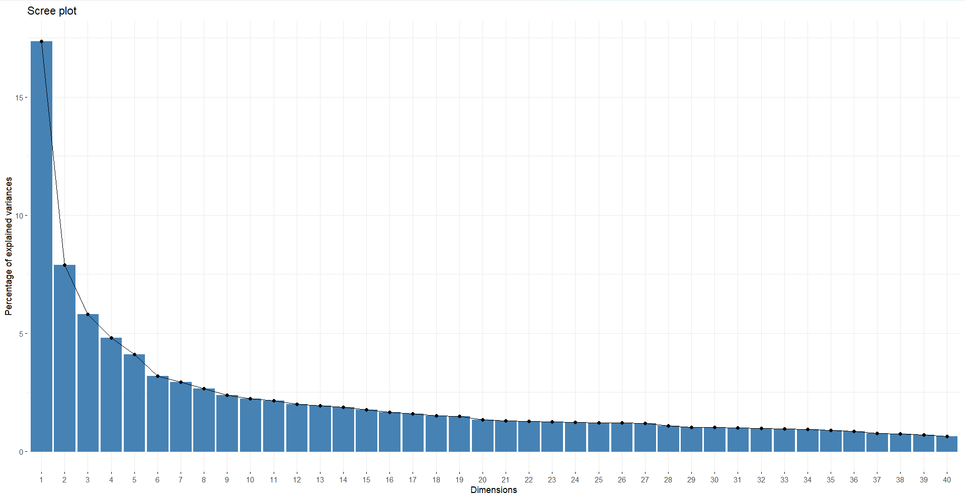
Principal Component Analysis
The first few principal components (e.g., Dim 1 and Dim 2) explain the majority of the variance, with Dim 1 contributing over 15%. The curve shows a sharp drop (elbow) after the first few dimensions, indicating diminishing returns in variance explained. Components beyond approximately 5 dimensions contribute minimally to the overall variance, suggesting they can be discarded for dimensionality reduction.
Dim 1 (17.36%) and Dim 2 (7.88%) capture most variance. Vital signs (h1_sysbp_max, h1_mbp_max) show strong correlation. Variables like apache_4a_hospital_death_prob and ventilated_apache dominate Dim 1. Central scatter reflects less influential or balanced variables. Opposite directions (e.g., d1_temp_min vs. solid_tumor_with_metastasis) indicate negative correlation.
Variables are clustered together in the center of the graph. Variables are also spread out towards the edges of the graph. The graph has a circular grid in the background. The axes are labeled "Dim 1" and "Dim 2" with corresponding percentages

Slide 5
Factor Analysis
Uniqueness's
Low uniqueness: Variables well-explained by factors (e.g., apache post operative = 0.022, gcs motor apache = 0.257).
High uniqueness: Variables poorly explained by factors (e.g., arf apache = 0.992, weight = 0.804).
Factor Loadings
Strong loadings indicate strong relationships:
Elective surgery: Factor 2 (0.916).
Height: Factor 7 (0.948).
Apache post operative: Factor 2 (0.971).
Gcs eyes apache: Factor 1 (-0.870).
Variance Explained
Factor 1: Explains 7.2%.
Factor 2: Explains 6.8%.
Cumulative variance (10 factors): 42%.
Model Fit
Chi-square statistic: 160,350.9 (df = 693).
P-value near 0
Uniqueness's
Low uniqueness: Well-explained by factors (e.g., apache post operative = 0.022, gcs motor apache = 0.257).
High uniqueness: Poorly explained by factors (e.g., arf apache = 0.992, weight = 0.804).
Factor Loadings
Promax allows correlated factors, resulting in higher loadings:
Elective surgery: Factor 2 (0.934).
Height: Factor 7 (0.961).
Gcs eyes apache: Factor 1 (-0.951).
Gcs motor apache: Factor 1 (-0.890).
Variance Explained
Factor 1: 5.9%.
Factor 2: 5.8%.
Cumulative (10 factors): 41.9% (slightly lower than Varimax).
Factor Correlations
Notable correlations:
Factor 1 and Factor 5: 0.577.
Factor 7 and Factor 8: 0.239.
Model Fit
Chi-square statistic: 160,350.9 (p-value = 0).

Slide 6
Regression Analysis
Residuals
Range: -0.836 to 1.181 (symmetric with some outliers).
Coefficients
Significant Predictors (p < 0.05):
Positive Effects: Age, icu_admit_source, ventilated_apache, apache_4a_hospital_death_prob.
Negative Effects: Elective_surgery, weight, d1_sysbp_min, d1_temp_min, diabetes_mellitus.
Largest Coefficients:
Apache_4a_hospital_death_prob (0.147).
Apache_4a_icu_death_prob (0.140).
Model Fit
Residual Standard Error: 0.249.
R-squared: 0.2115 (21.15% variance explained).
Adjusted R-squared: 0.2107 (adjusted for predictors).
F-statistic: 262.7 (p-value < 2.2e-16, overall significance).
Accuracy
Predictive accuracy: 92.29%.
Error Metrics
RMSE: 0.2484 (average prediction error).

Slide 7
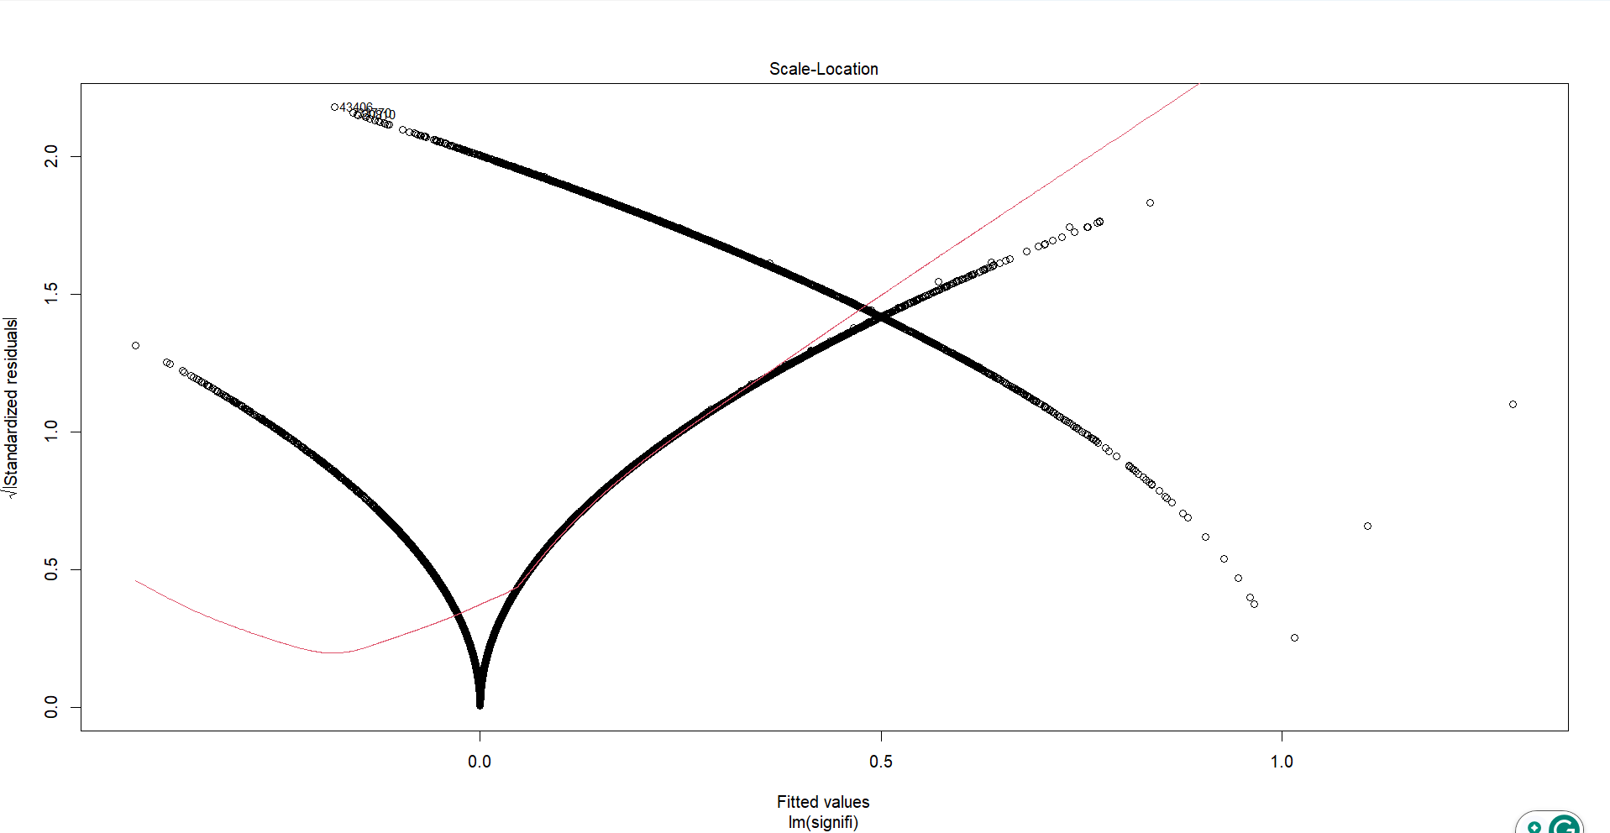
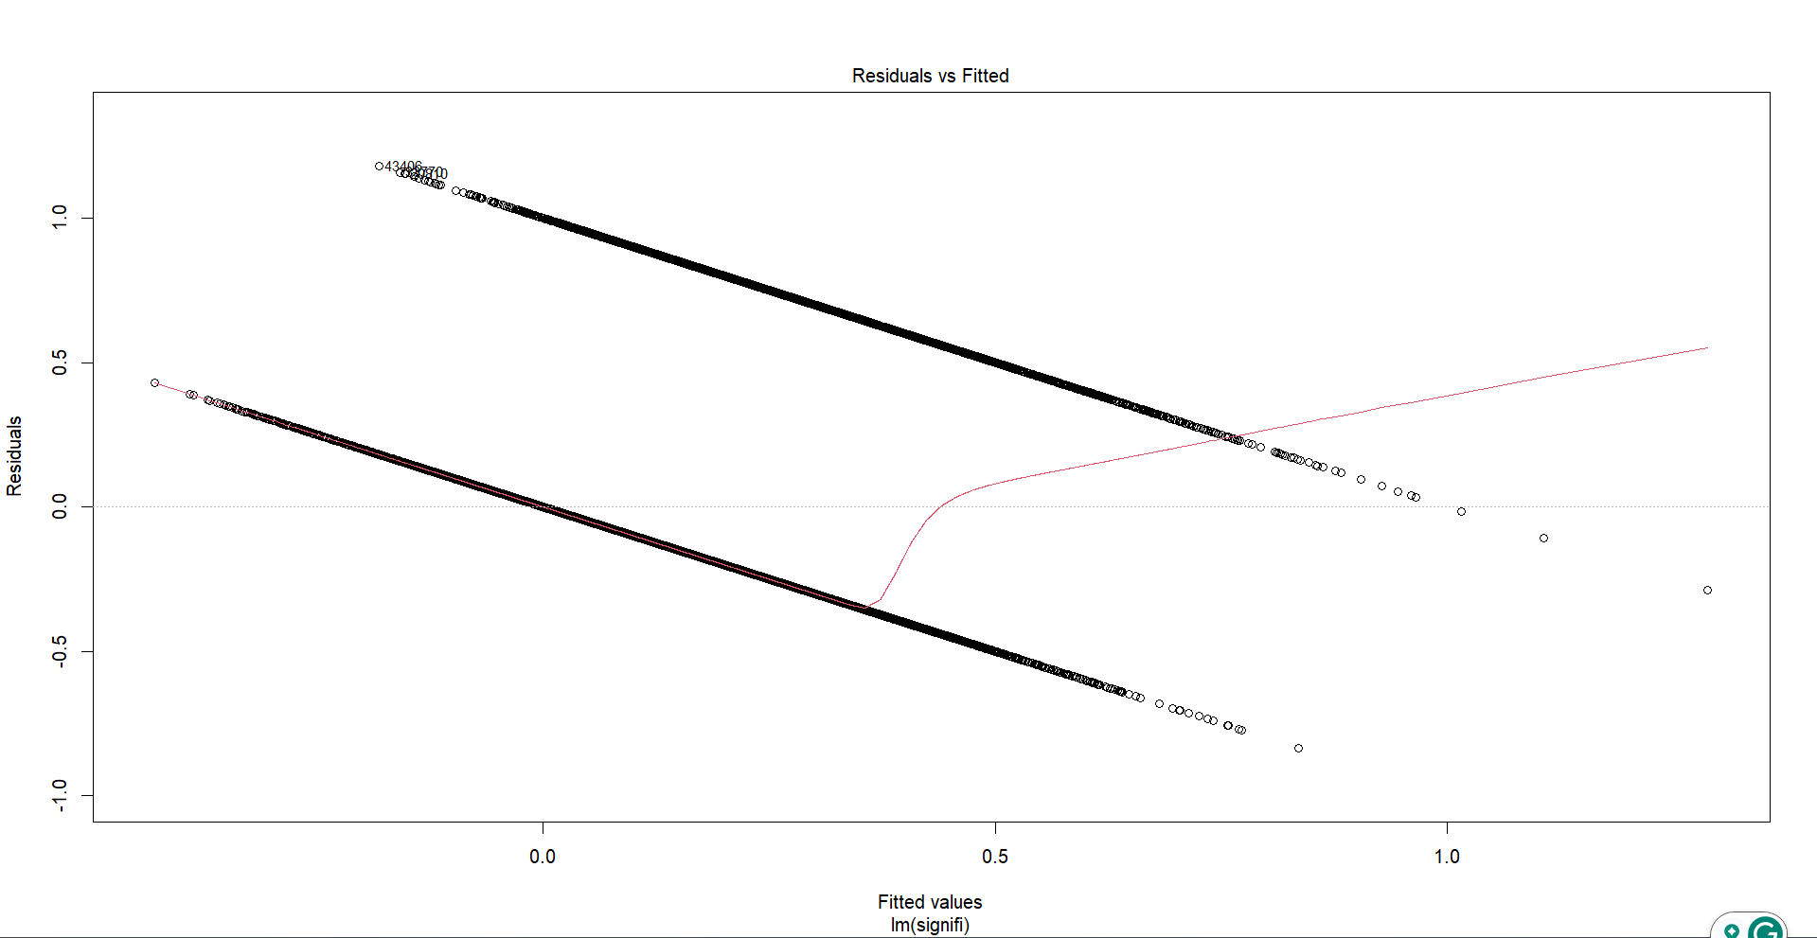
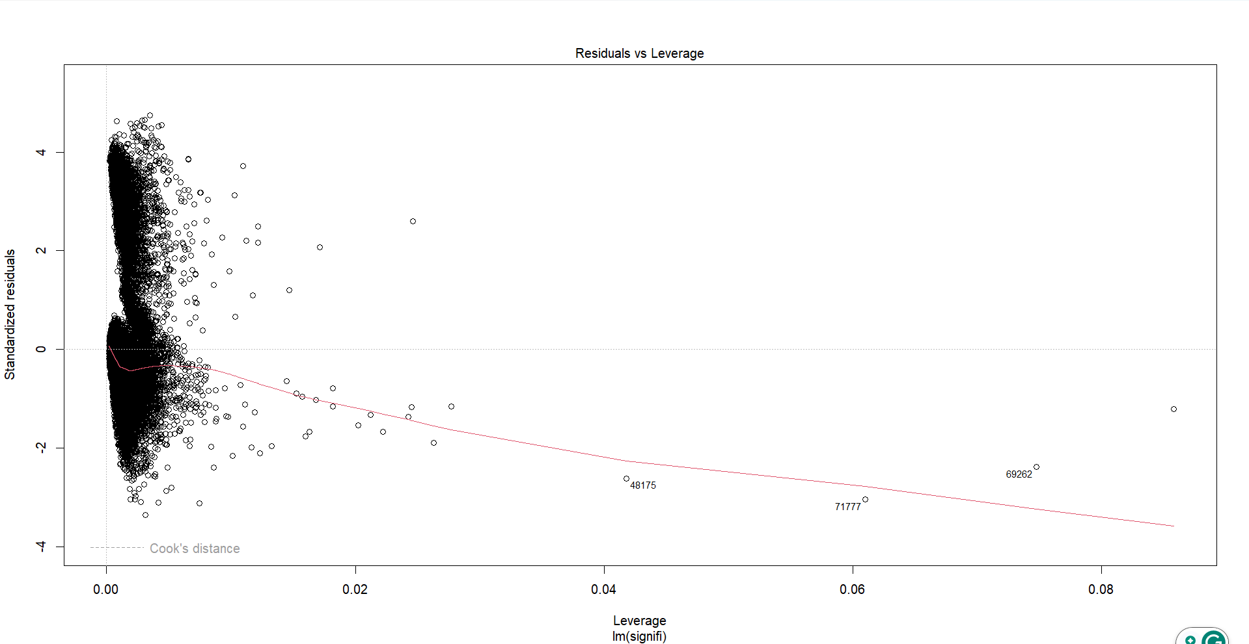
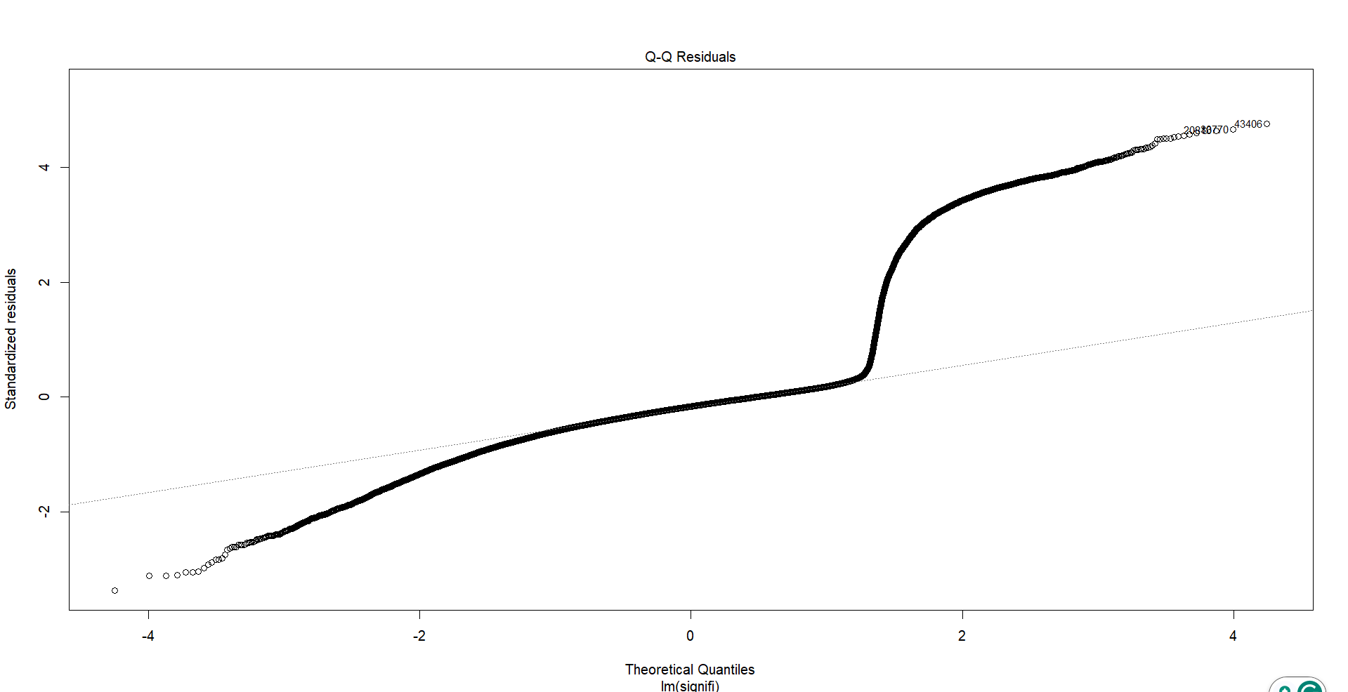
Mean(model$residual) = -7.78583e-18
Ad.test = p-value < 2.2e-16
bp-test = p-value < 2.2e-16
durbinWatsonTest: p-value < 0.672

Slide 8
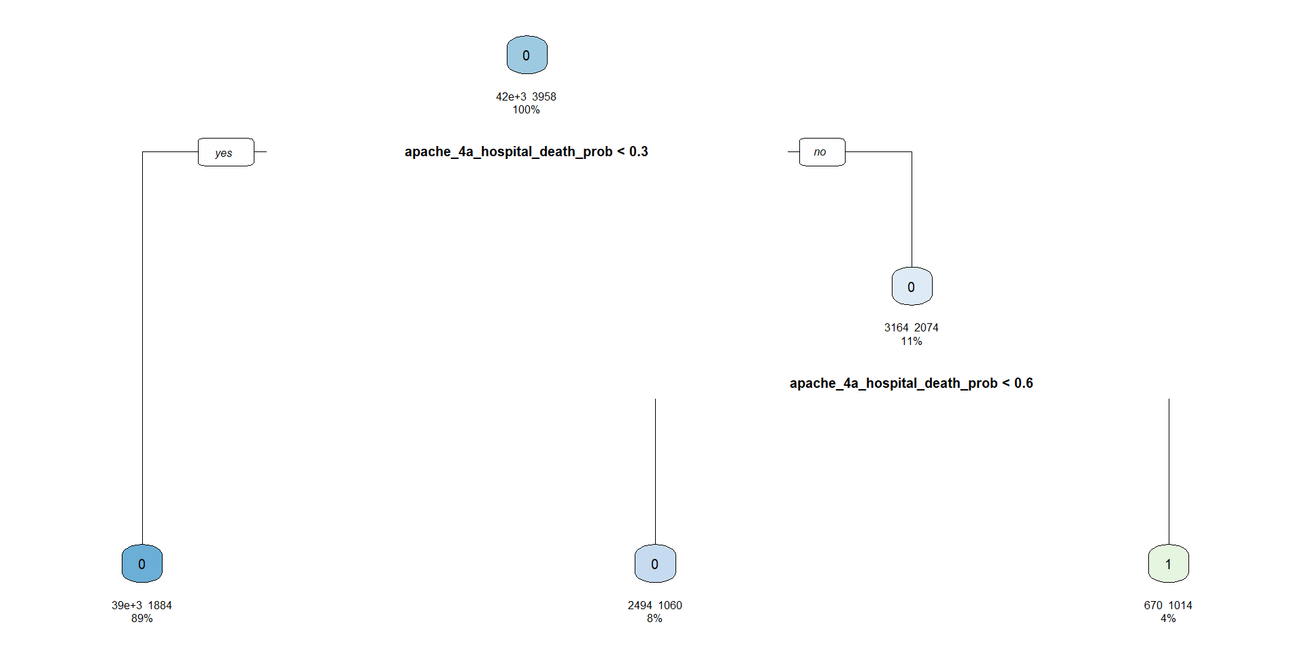
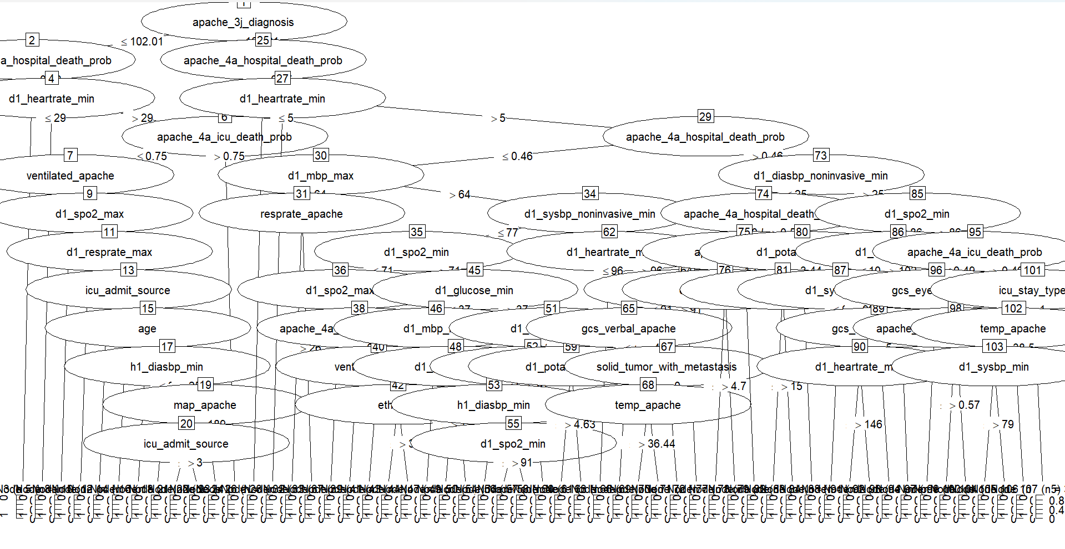
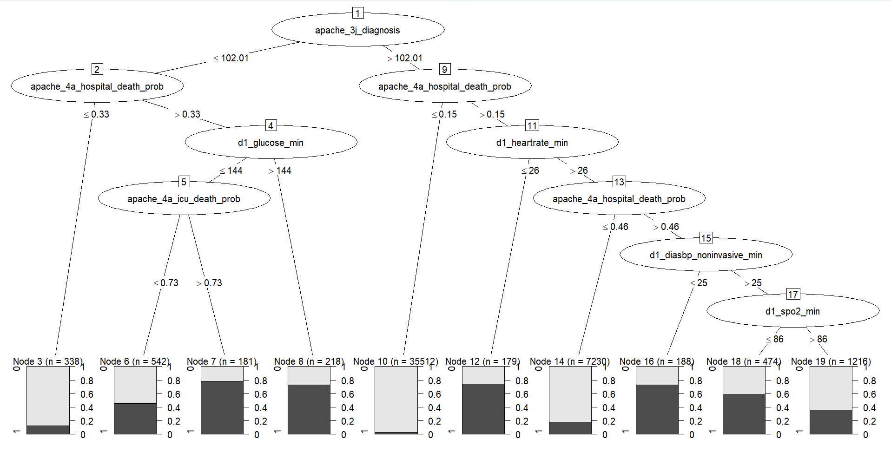
Decision Tree
CPART Decision Tree
Accuracy = 91.96%
C5.0 Decision Tree
Accuracy = 92.02%
C50 Pruned Decision Tree
Accuracy = 91.94%
 | Actual
Predicted | 0 | 1
0 | 10370 | 760
1 | 166 | 224
 | Actual
Predicted | 0 | 1
0 | 10331 | 714
1 | 205 | 270
 | Actual
Predicted | 0 | 1
0 | 10412 | 805
1 | 124 | 179

Slide 9
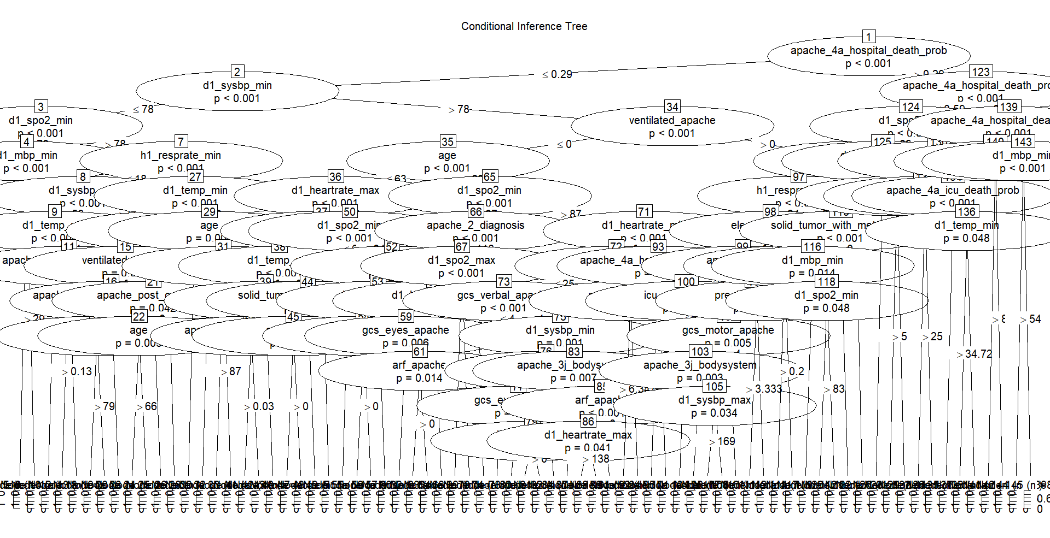
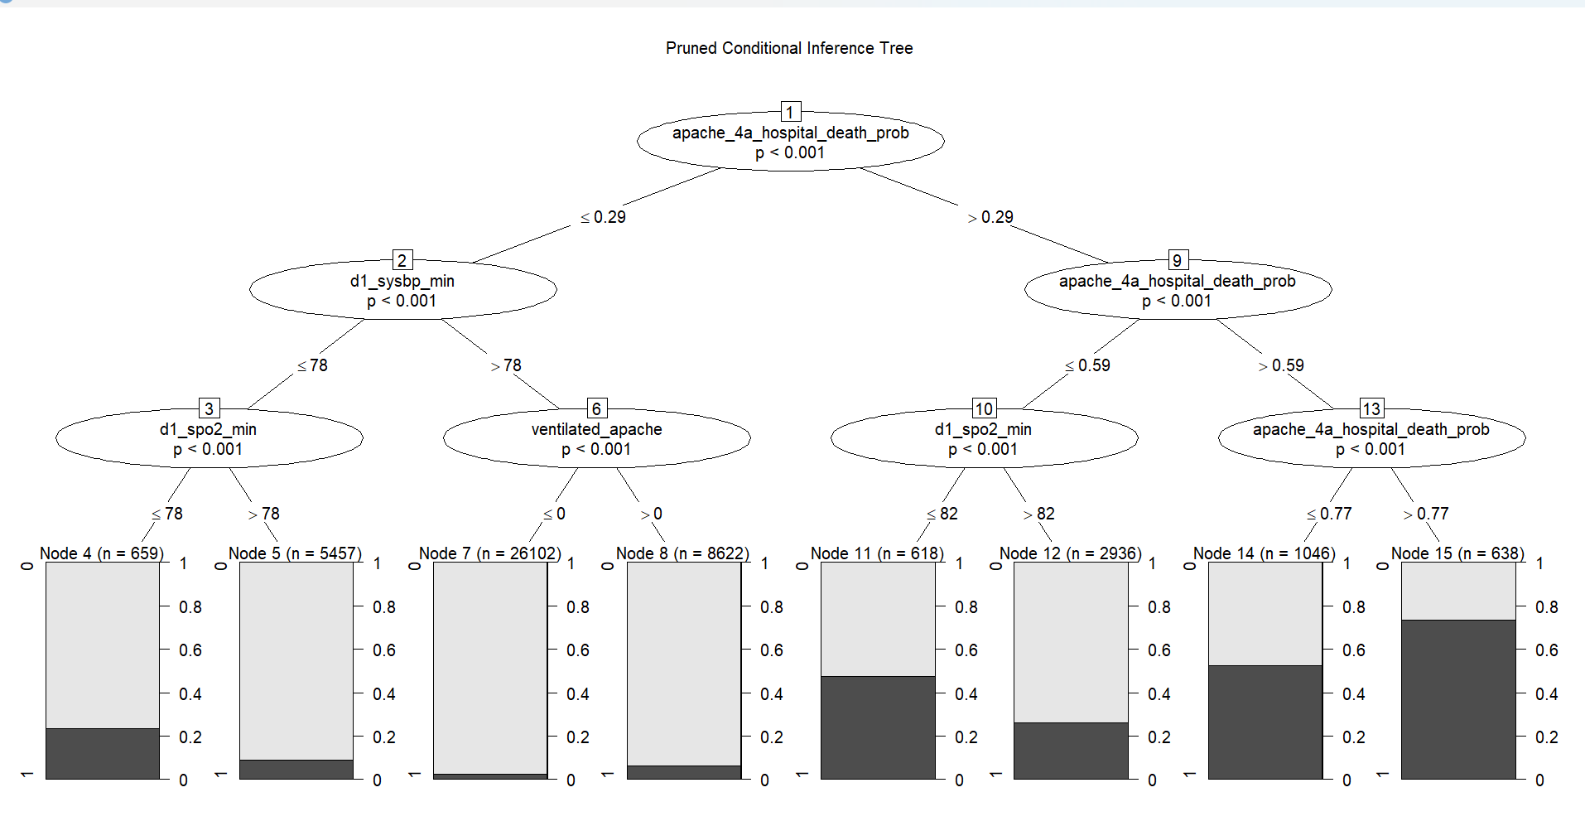
Decision Tree
CI Decision Tree
Accuracy = 92.07%
 | Actual
Predicted | 0 | 1
0 | 10417 | 795
1 | 119 | 189
CI Pruned Decision Tree
Accuracy = 91.96% (Final Model)
 | Actual
Predicted | 0 | 1
0 | 10370 | 760
1 | 166 | 224

Slide 10
Final Model – Decision Tree

Slide 11
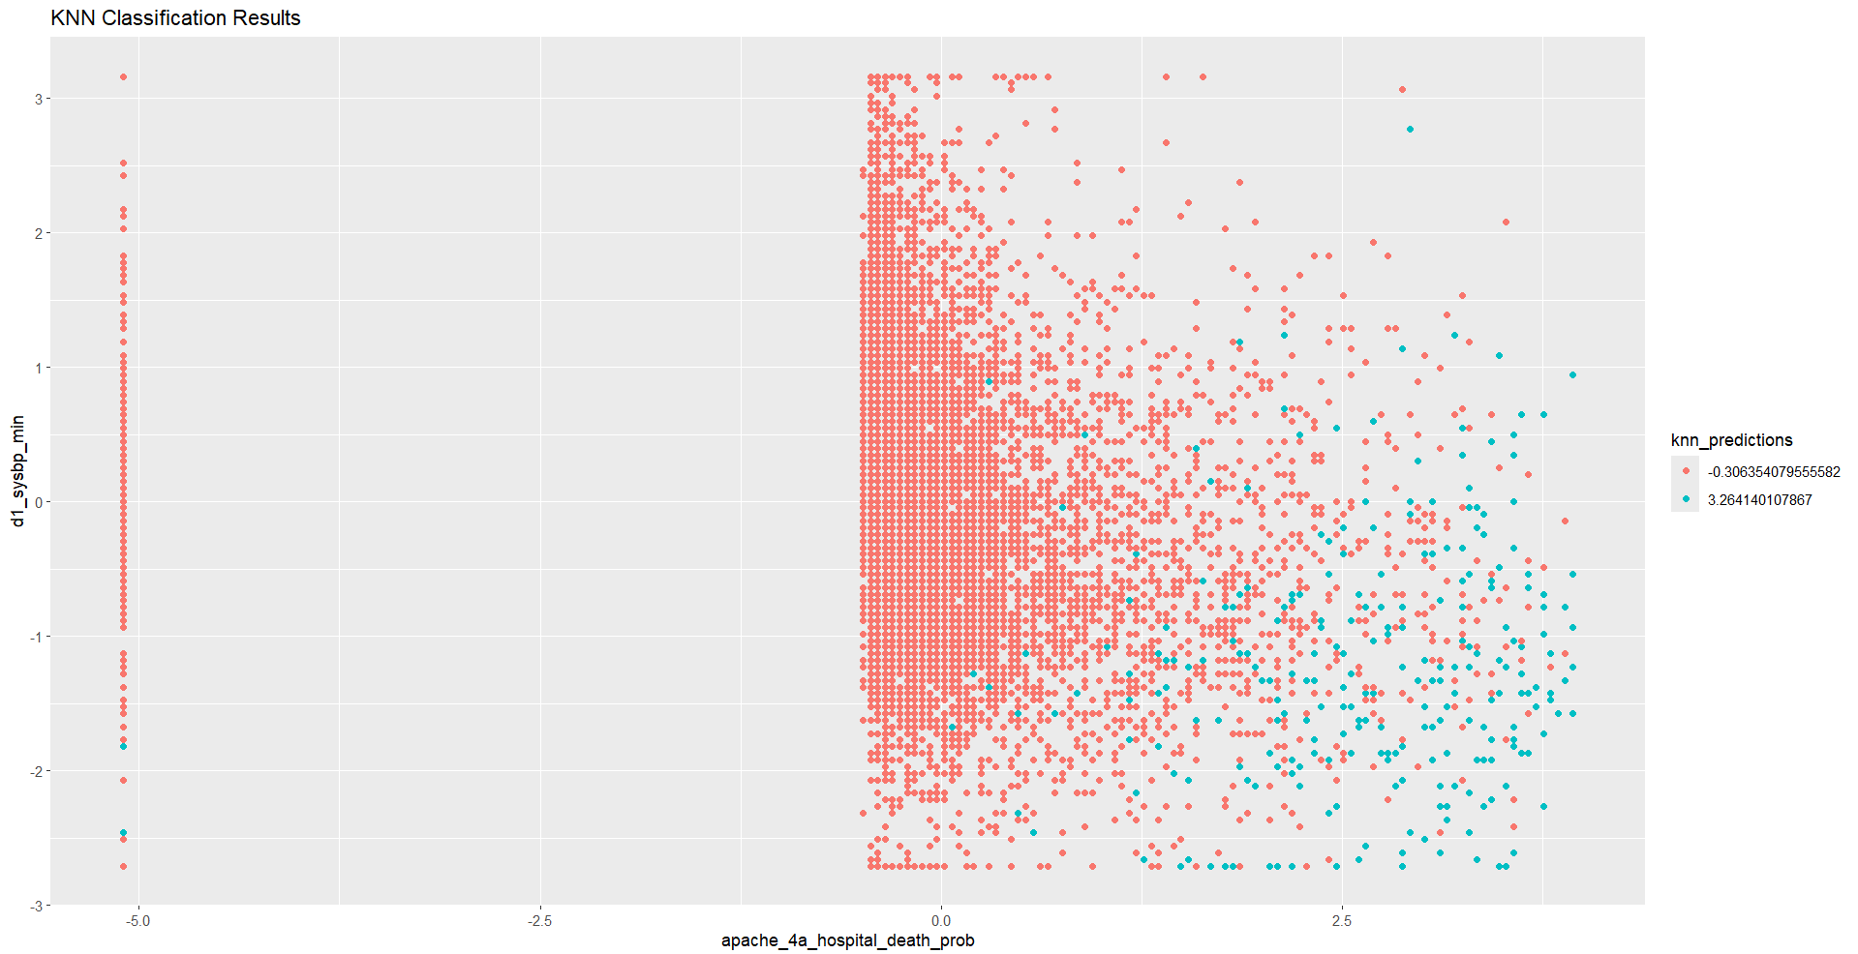

K- Nearest Neighbour
K = 7
Accuracy: 92.10%
 | Actual
Preducted | 0 | 1
0 | 10437 | 811
1 | 99 | 173
K = 13
Accuracy: 92.10%
 | Actual
Predicted | 0 | 1
0 | 10481 | 837
1 | 55 | 147

Slide 12
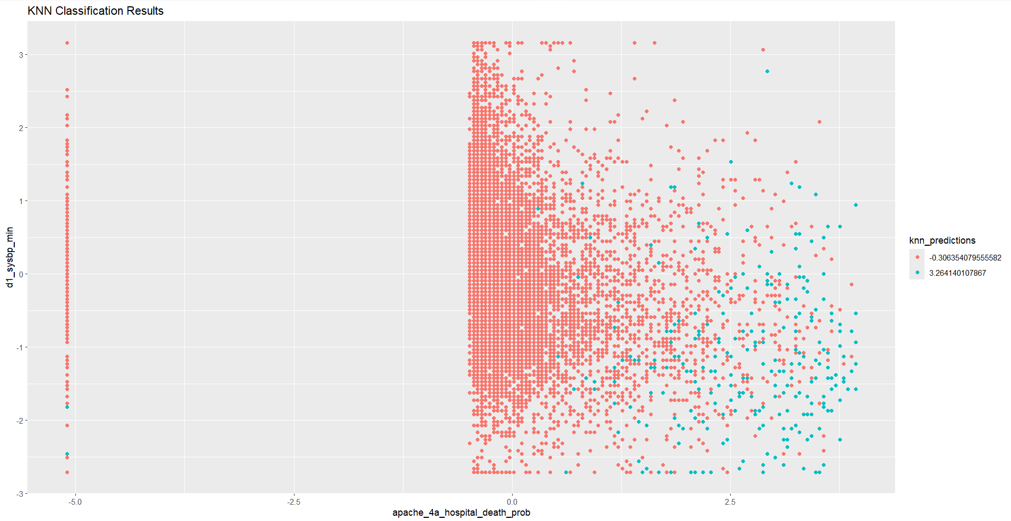
Final Model - KNN
K = 9
Accuracy: 92.20%
 | Actual
Predicted | 0 | 1
0 | 10450 | 812
1 | 86 | 172

Slide 13
Conclusion
Best Model: Linear Regression
Reason: The multiple linear regression model achieved a slightly higher predictive accuracy (92.29%) compared to the pruned decision tree (92.20%). Additionally, it provides detailed insights into predictor significance and effect sizes, making it more interpretable and useful for understanding the relationships between variables.
Worst Model: Pruned Decision Tree (depth = 3)
Reason: Although the pruned decision tree performs well with a 92.20% accuracy, it slightly underperforms compared to the linear regression model. It also lacks the granularity in identifying the influence of individual predictors, making it less informative for drawing actionable conclusions.

Slide 14
Future Enhancement
Incorporate advanced machine learning techniques (e.g., Random Forests, Gradient Boosting) to capture non-linear effects missed by linear regression.
Outliers and high residual variance (-0.836 to 1.181) will be addressed to improve model robustness and fit.
Models will be tested on an independent dataset to assess generalizability and ensure consistent predictive performance.
Regular updates will be implemented with new data to maintain relevance and adapt to changes in predictor relationships.

